Slide 1
Telco – Customer Churn
Annapoorani
Capstone Project 2

Slide 2
Problem Statement
Predict behavior to retain customers. To can analyze all relevant customer data and develop focused customer retention programs.

Slide 3
Approach
Data Wrangling using Python Pandas, so that data is cleaned and readily available for analysis
EDA to discover the underlying facts about the data and to study the different features
Applying machine learning algorithms like Logistic regression, Decision Trees and Deep Learning.

Slide 4
Data Wrangling
Converting the Total and Monthly charges to numeric
Checked for any NA values in the columns, identified very few rows with Total Charges as NA and those rows are dropped
.

Slide 5
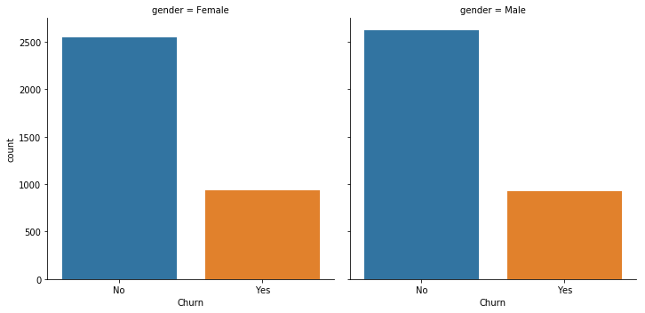
Exploratory Data Analysis Churn Based on Gender

Slide 6
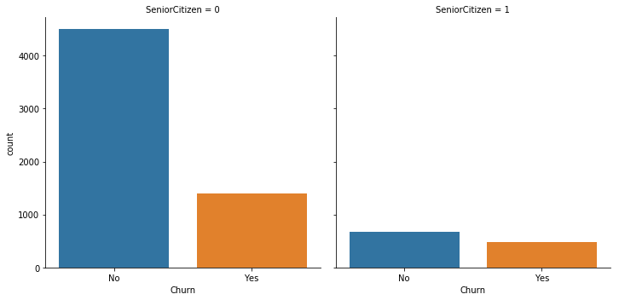
Churn behavior – Senior Citizen

Slide 7
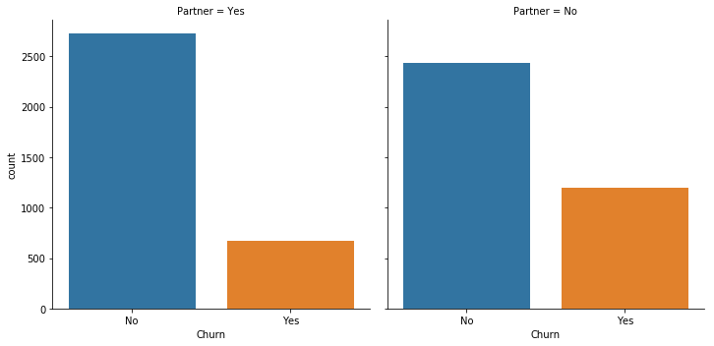
Churn - Partners

Slide 8
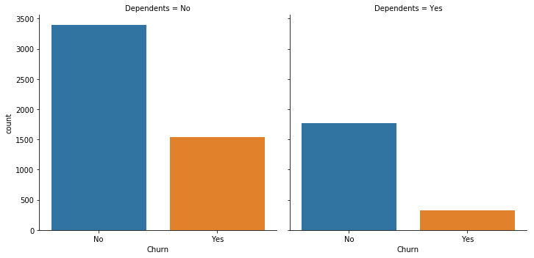
Churn based on No of Dependents

Slide 9
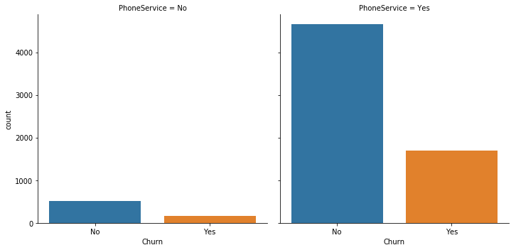
Churn – Customer with Phone Service

Slide 10
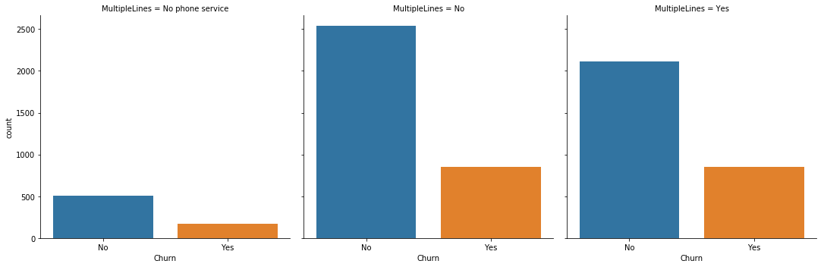
Churn – Customer with Multiple Lines

Slide 11
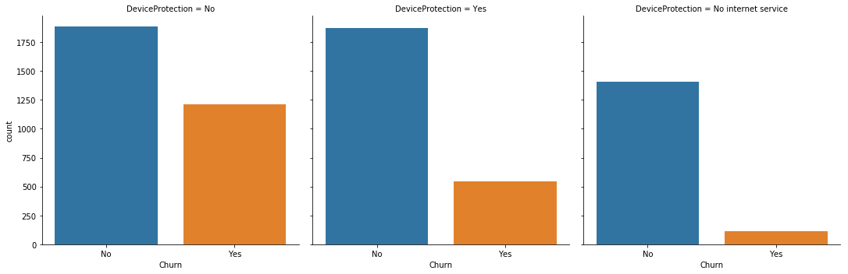
Device Protection – Customer Churn

Slide 12
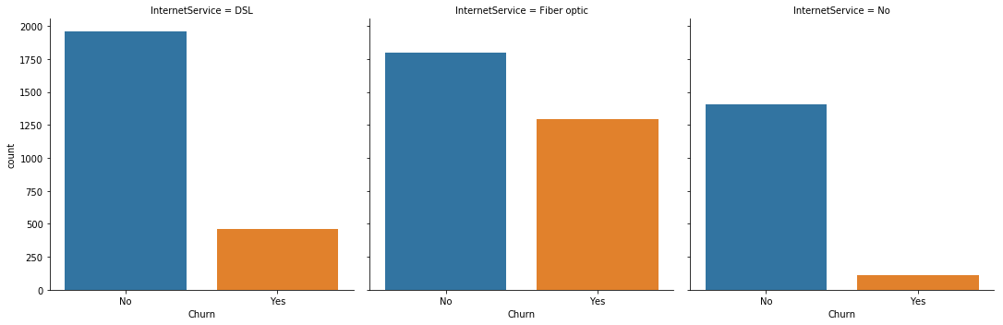
Churn based on Internet Service

Slide 13
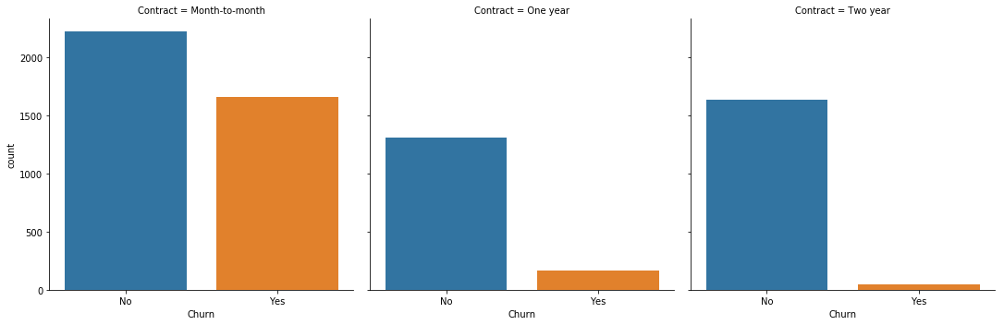
Customer Churn - Contracts

Slide 14
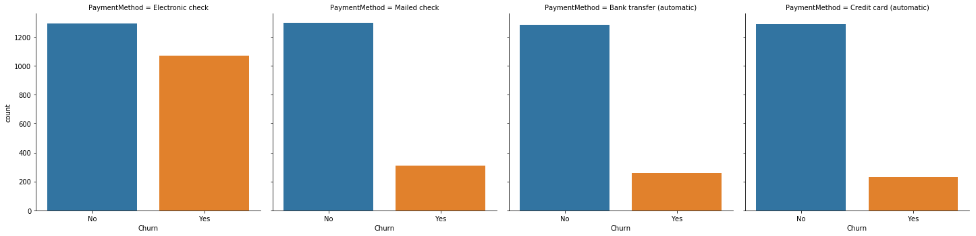
Churn – Payment Method

Slide 15
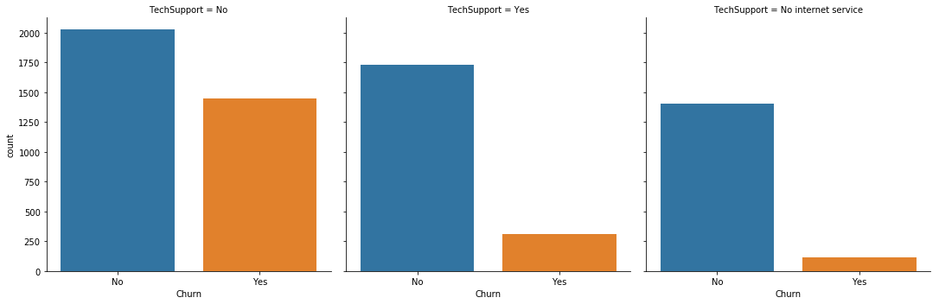
Churn due to Tech Support

Slide 16
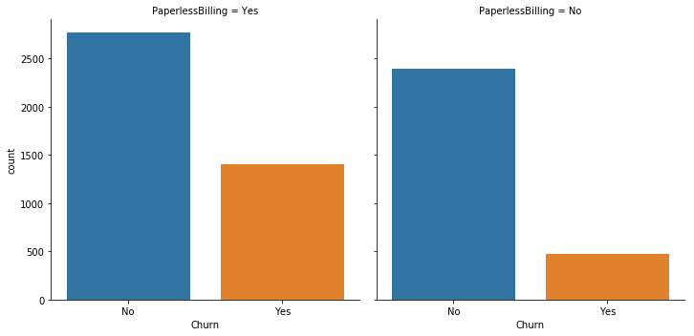
Churn based on Billing Method

Slide 17
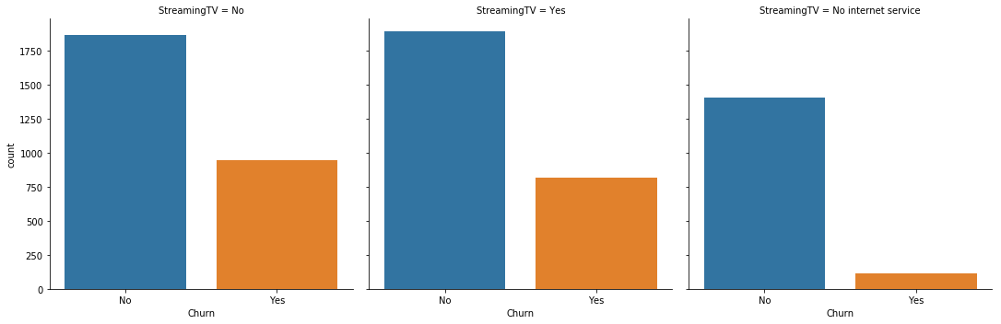
Streaming TV Customer Churn

Slide 18

Streaming Movies Customer Churn

Slide 19
Feature Engineering
From EDA - Primary Features
Internet Service
Contract
Payment Method
Streaming Tv
Streaming Movies
Tech Support
Secondary Features
Senior Citizen
Paperless Billing

Slide 20
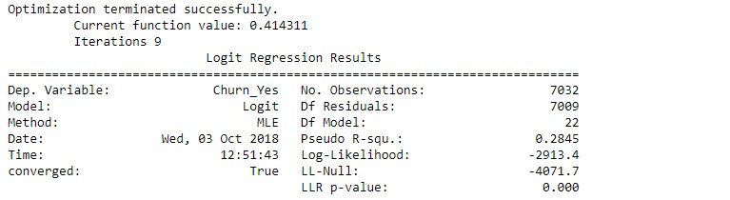
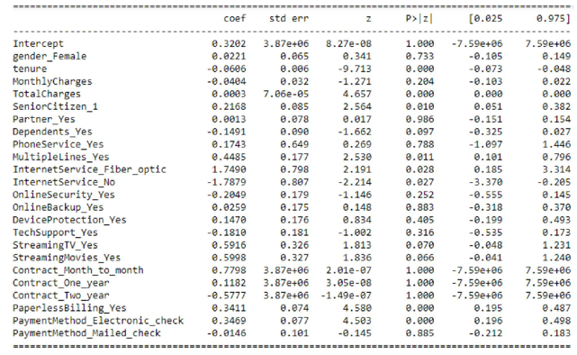
Stats Model - Logit

Slide 21
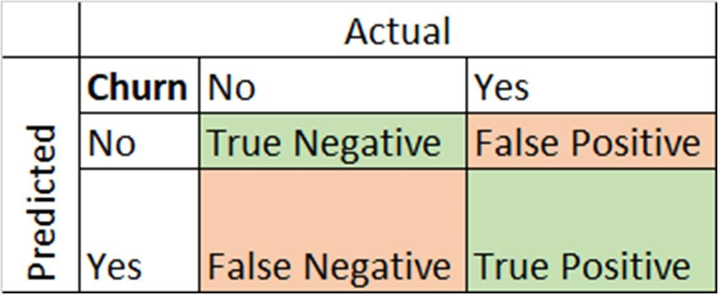
Classification – Confusion Matrix
True Positive - Actual Data point is positive and Predicted as positive
True Negative - Actual Data point is negative and Predicted as negative
False Positive - Actual Data point is negative and Predicted as positive
False Negative - Actual Data point is positive and Predicted as negative.

Slide 22
Classification - Metrics
Precision = True Positives/ (True Positives + False Positives)
Recall = True Positives/ (True Positives + False Negatives)

Slide 23
SMOTE
Synthetic Minority Over-sampling Technique
Over-sample the minority class.
Under-sample the majority class. •
Synthesize new minority classes.

Slide 24
Measures – Classification Algorithms
 |  | Before SMOTE |  | After SMOTE |  | SMOTE less Features
 |  | Precision | Recall | Precision | Recall | Precision | Recall
Logistic | 0 | 0.84 | 0.89 | 0.91 | 0.73 | 0.91 | 0.66
 | 1 | 0.61 | 0.51 | 0.51 | 0.8 | 0.46 | 0.81
Decision | 0 | 0.83 | 0.79 | 0.83 | 0.78 | NA | NA
 | 1 | 0.47 | 0.53 | 0.47 | 0.54 | NA | NA
Random | 0 | 0.82 | 0.89 | 0.82 | 0.88 | 0.9 | 0.68
 | 1 | 0.59 | 0.44 | 0.57 | 0.44 | 0.47 | 0.79
svm | 0 | 0.78 | 0.94 | 0.81 | 0.84 | 0.91 | 0.64
 | 1 | 0.68 | 0.25 | 0.49 | 0.44 | 0.45 | 0.83
XG Boost | 0 | 0.83 | 0.9 | 0.85 | 0.85 | 0.9 | 69
 | 1 | 0.63 | 0.48 | 0.58 | 0.58 | 0.47 | 0.78

Slide 25
Conclusion
Based on business question and problem we try to solve other measures are equally important.
As for the problems like Customer Churn, Credit defaulters and Spam emails mainly based on recall value.
Each problem is different so gauging against all the algorithms will be a better choice.
For future analysis, still improvement on Feature Engineering and fine tuning the parameters will give better results.

